Slide 1
Movies part 4
Barb Ericson
Georgia Institute of Technology
April 2006

Slide 2
Learning Goals
Media Goals
  To generate special effects like a person fading out of a scene
  To add an object to an existing movie
Computing Concepts
  To add parameters to methods to make them reusable
  To reuse earlier methods in making movies

Slide 3
Fading Out or In
You can change the threshold on
  swapBackground(backgroundPicture,
  newBackPicture,threshold);
  In the loop
  To swap more background over time
  You can even make the person in the picture disappear over time

Slide 4
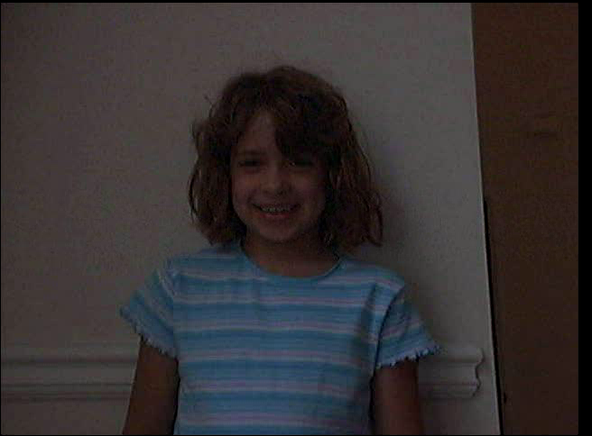
Fade Out Movie
Notes:
This mpeg file was created with ImageMagick using
convert –adjoin –border 1 –bordercolor black frame*.jpg frame.mpeg
Click on the movie to play it.

Slide 5
Code for Fade Out Movie
public void makeFadeOutMovie(String directory)
{
// load the pictures
String kidF = FileChooser.getMediaPath("kid-in-frame.jpg");
Picture kidP = null;
String wallF = FileChooser.getMediaPath("bgframe.jpg");
Picture wallP = new Picture(wallF);
String beachF = FileChooser.getMediaPath("beach.jpg");
Picture beachP = new Picture(beachF);
// declare other variables
FrameSequencer frameSequencer =
new FrameSequencer(directory);
int framesPerSec = 30;

Slide 6
Code for Fade Out Movie - Cont
// loop creating the frames
for (int i = 0; i < framesPerSec * 2; i++)
{
kidP = new Picture(kidF);
kidP.swapBackground(wallP,beachP,i);
frameSequencer.addFrame(kidP);
}
// play the movie
frameSequencer.play(framesPerSec);
}

Slide 7
Main for Testing
public static void main(String[] args)
{
MovieMaker movieMaker =
new MovieMaker();
String dir =
"c:/intro-prog-java/movies/fade/";
movieMaker.makeFadeOutMovie(dir);
}
Notes:
You can change the path for the directory to write the frames to.

Slide 8
Exercise
Create a new method in MovieMaker
Make a movie where you increase the amount of edge detection over time which will make the picture disappear over time
  Be sure to start with the original picture each time

Slide 9
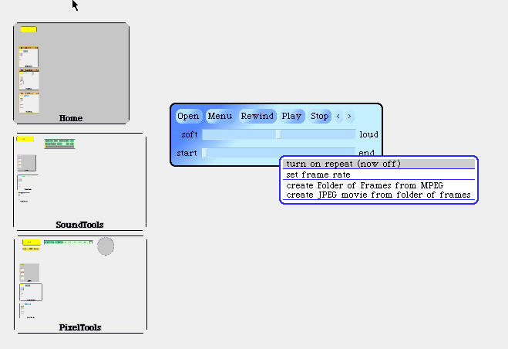
Changing A Movie
You can make a series of JPEG frames from a movie (MPEG)
  Using MediaTools
    Click in Video Tools
    Click on the Menu Button
      Then click on Create Folder of Frames from MPEG
  Or use QuickTime Pro
Notes:
To start MediaTools pick up the mediatools-v5-sa.image file and drop it on the SqueakVM.exe. Click in the VideoTools window to open the Video Tools. Click on the Quit button to quit.

Slide 10
Adding Objects to Movies
Create a File object on the directory that holds the JPEG frames of the movie
Get a list of file names in the directory
  Using list()
Create a Picture of the image you want to copy
Loop through all the file names
  Create a picture from the current file name in the movie
  Copy into the picture the picture you want to copy
    Change the location each time through the loop
  Add the picture to the FrameSequencer

Slide 11
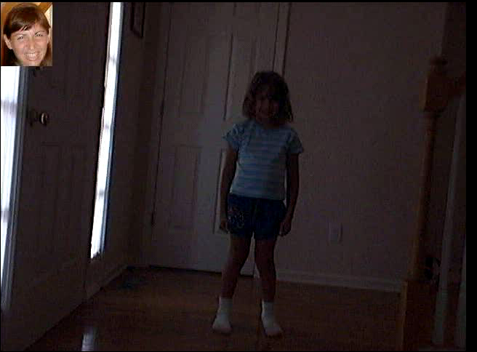
Mommy Watching Katie Dance
Notes:
This mpeg file was created with ImageMagick using
convert –adjoin –border 1 –bordercolor black frame*.jpg frame.mpeg
Click on the movie to play it.

Slide 12
Code for Mommy Watching Movie
public void makeMommyWatchingMovie(String dir)
{
String barbF = FileChooser.getMediaPath("barbaraS.jpg");
String katieDir =
FileChooser.getMediaPath("kid-in-bg-seq/");
Picture barbP = new Picture(barbF);
FrameSequencer frameSequencer = new FrameSequencer(dir);
Picture currP = null;
// get the array of files in the directory
File dirObj = new File(katieDir);
String[] fileArray = dirObj.list();

Slide 13
Code for Mommy Watching Movie - Cont
// loop through the array of files
for (int i = 0; i < fileArray.length; i++)
{
if (fileArray[i].indexOf(".jpg") >= 0)
{
currP = new Picture(katieDir + fileArray[i]);
currP.copy(barbP,22,9,93,97,i * 3, i * 3);
frameSequencer.addFrame(currP);
}
}
// play the movie
frameSequencer.play(30);
}

Slide 14
Main for Testing
public static void main(String[] args)
{
MovieMaker movieMaker =
new MovieMaker();
String dir =
"c:/intro-prog-java/movies/mommy/";
movieMaker.makeMommyWatchingMovie(dir);
}
Notes:
You can change the directory that the frames are written to.

Slide 15
Exercise
Create a new method in MovieMaker
Make a movie with the turtle in turtle.jpg crawling across the frames of the movie in mediasources/blowhole
  How would you vary the speed of the turtle, so that it gets faster as it moves from left to right?

Slide 16
Summary
You can do movie special effects
  Like having a person fade in or out
You can add objects to an existing movie
  Break the movie into a series of JPEG
  Modify the frames
Adding parameters to methods makes them easier to reuse
You can have more than one method with the same name in a class
  As long as the parameter list is different

